Slide 1

To ask questions during this event please search Slido.com into your web-browser and enter the code #FFL3
AREF FutureGen Network
Back to Basics –
Fund Deployment & Launch
Wednesday 21st August 2019

Slide 2
Welcome
Tom Pinnell
Chair of the AREF FutureGen Committee
Associate Director, BD at Langham Hall

Slide 3

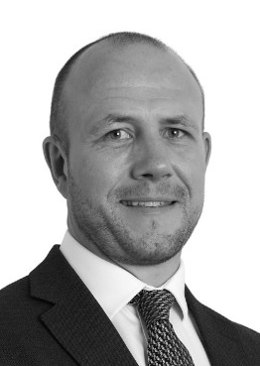
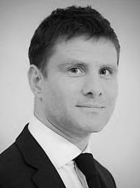
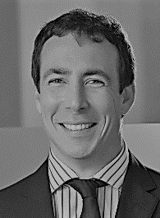

Speakers
Alex Moss
Cass Business School
Neil Meikle
Aberdeen Standard Investment
Ed Crockett
Aberdeen Standard Investment
Andrew Boyce
Carey Olsen

Slide 4
Alex Moss
Director, Real Estate Research Centre
Cass Business School
Alex.moss.1@city.ac.uk

Slide 5



Cass Real Estate Research Centre
Building the bridge between theory and practice
Launched in Q4 2018, the Centre’s purpose is to provide a dynamic link between the academic community and practitioners involved in real estate.
Key objectives:
Produce reports on a commissioned and ad hoc basis on under-researched areas of industry interest
Host events on topical issues for the industry
Facilitate the production of academic papers for publication in journal and conferences
Offer dedicated Executive Education courses for industry practitioners
Funding is via sponsorship from industry partners
Sign up to the mailing list on the website to receive details of forthcoming events
https://www.cass.city.ac.uk/faculties-and-research/centres/real-estate

Slide 6
Ed Crockett
Head of UK Residential Investment
Aberdeen Standard Investment

Slide 7
Neil Meikle
Head of Product Strategy
Aberdeen Standard Investment

Slide 8
What is a Real Estate Fund?
“A Fund is when multiple clients pool in a structure to invest in multiple assets”

Slide 9
Poll Question:
When developing a Fund what is the most important element to consider?
To answer this poll please search Slido.com in your web-browser and enter the code below:
Slido.com
Ref:#FFL3

Slide 10
The most important thing to consider when launching a fund?
The Client

Slide 11
What’s does the client focus on when investing in a fund?
Clients want everything…
Strategy: It’s a sure thing and it can’t fail.
Team: Marvel superheroes
Returns: Guaranteed please!
Risk: None!
Service: Incredible customer experiences- can I visit the assets?
Fees: No thanks.

Slide 12
What we aim to deliver
Compelling investment propositions which deliver on client requirements
Strategy: Research driven, high conviction investment propositions
Team: Experienced individuals with established track record
Returns: Risk adjusted and consistent
Risk: Minimised at every opportunity
Service: A focus on delivering client reporting needs
Fees: Premium products can charge premium fees

Slide 13
Profitable funds share a common set of attributes
What aspects do we target when launching a fund
1. They are client focused | 2. The draw on strong investment capability
Addressing a specific client need | Strong investment team in place
Potential for co-creation | Established track record
Innovative or differentiated product or solution | Clear rationale as to “why ASI”
Less susceptible to ‘in-house’ implementation | Established strategy or fund series
Useful bundling of capabilities or otherwise demonstrable alpha
3. They have attractive economics | 4. They are marketable
Attractive fees | Large addressable market
Sustainable value proposition | Recognised brand & reputation
Scalable strategy | Potential cornerstone investors identified
Long product duration | Appropriate client relationships & re-upping clients

Slide 14
Product Features
What do new strategies look like
Strategy: thematic, opportunity driven, structural shifts, ESG, single asset class, multiple asset classes, focussed, diversified
Team: track record, location, how many people work on the fund, how do they get paid
Returns: Core to value-add/opportunistic, income/capital gains, benchmarks
Risk: a diversifier? Market risks, asset risks, currency, development
Service: reporting requirements, advisory committee
Fees: ASI profitability with client alignment

Slide 15
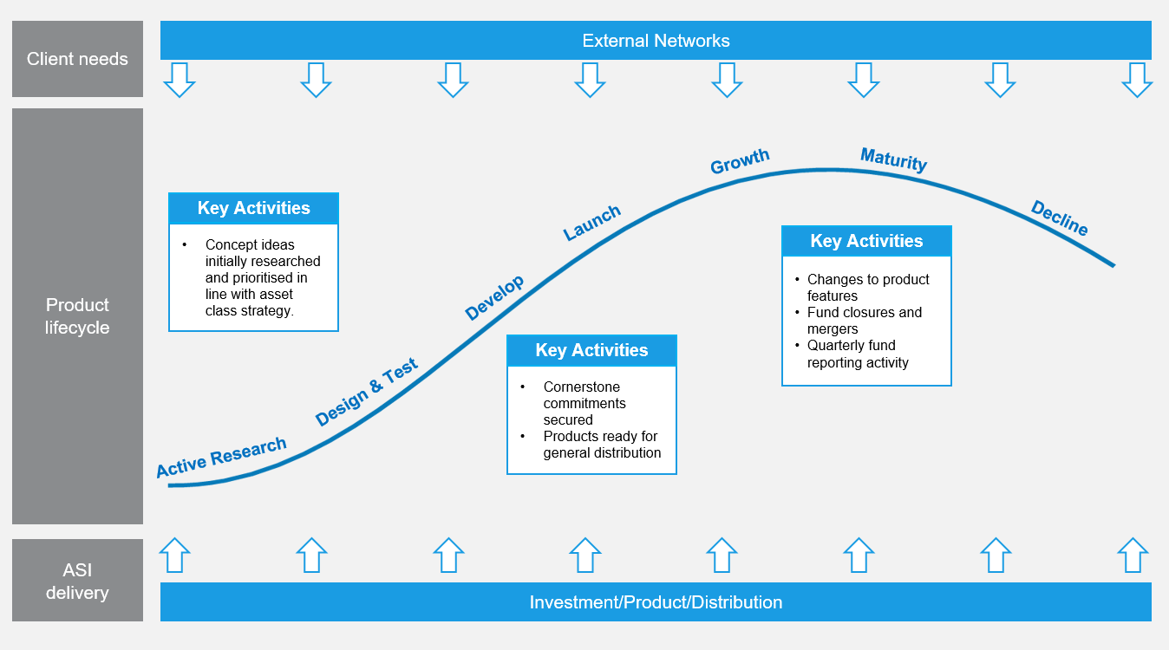
The Product Creation Lifecycle
Understanding client needs throughout

Slide 16
Case study: Aberdeen Standard Pan European Residential Property Fund
Delivering on a challenging client requirement
“It simply isn’t possible to have a fund which invests in Multi-family across Europe. The difference in language, laws and currency make it too expensive to manage and too risky for investors”

Slide 17
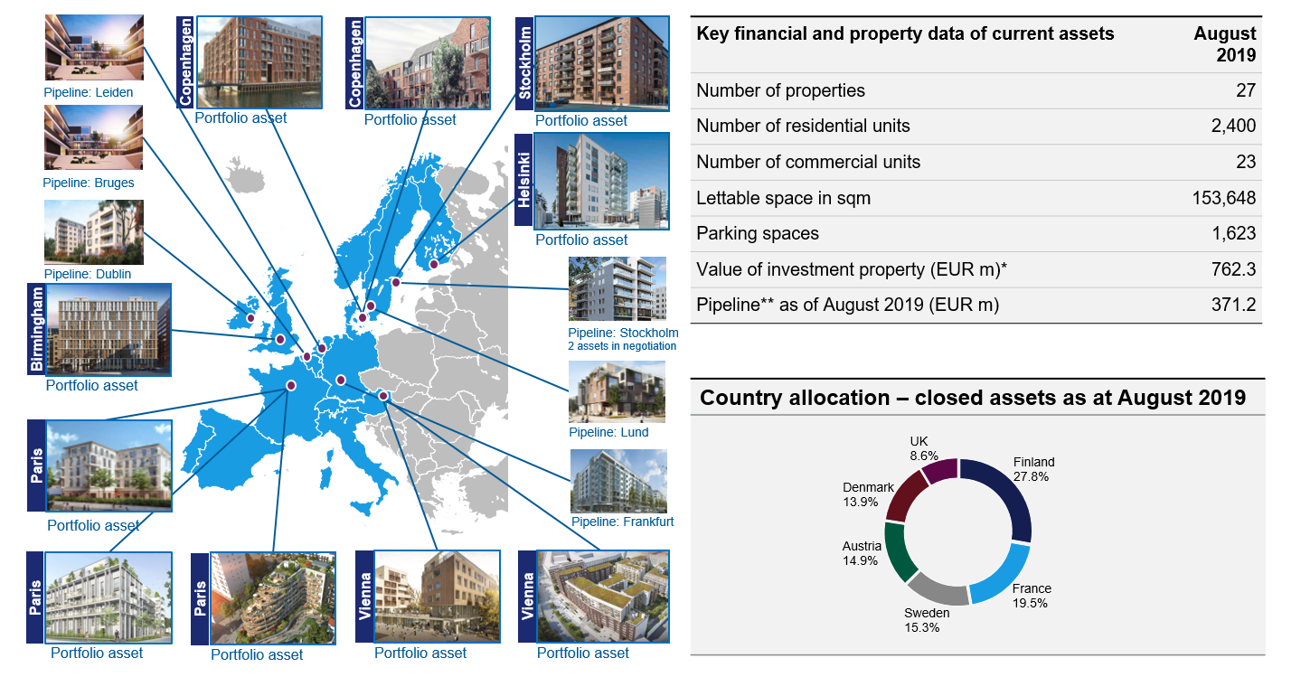
Case study: Aberdeen Standard Pan European Residential Property Fund
A flagship fund holding prized assets across western Europe
* Value of investment property are valuations of current assets assuming completion as at 30 June 2019 **Pipeline assets as per August 2019 Source: Aberdeen Standard Investments, August 2019

Slide 18




Case study: Aberdeen Standard Pan European Residential Property Fund
Continued Investor Support
Since the initial launch a total of over €540m of equity has been raised
Fund now supporting an investor base from the Netherlands, Switzerland, Germany, France, Ireland, Luxembourg , South Korea and the UK
> €250m of active client due diligence in train
Helsinki Portfolio, Finland
Bolværket, South Harbour, Copenhagen, Denmark

Slide 19
Welcome
Andrew Boyce
Partner, Carey Olsen

Slide 20
Poll Question:
Which of the following will impact launch and deployment of a fund?
To answer this poll please search Slido.com in your web-browser and enter the code below:
Slido.com
Ref:#FFL3

Slide 21
Introduction
Ready to go – time is up all advisers please step away from the product!
Planning
    Factors to consider when setting out launch plans
    Factors to consider when deploying capital
Investor negotiations – Doing a deal to do a deal
Know how the story ends right from the beginning

Slide 22

Launch – what do we need to think of?
By “launch” we mean the point at which we can actively receive investors:
Documentation
  Full suite of fund documents for the investors
  Do you have everything you need from the investors
Process
  single close, dry close, multiple closings, continuous subscription
Who is investing and how
  pooling vehicles, blockers, nominees, parallels

Slide 23
Deploying Capital – what do we need to think of?
Does the target asset fit within the investment strategy/objective of the fund
How is this being acquired
  Acquisition structure
    Holding entities, financing entities, servicing entities,
    sale and leaseback arrangements
  Payment structure
    Cash, management participation, earn-outs, options, deferred payments
  Funding flow
    Equity/debt split, convertible loan notes, external finance
Anticipate the exit
  Trade sale, portfolio sale, auction, IPO

Slide 24
Investor Negotiations – key points
Fees (management / performance)
“Waterfall”/returns provisions
Set up and ongoing costs and responsibilities
Key man/key advisor
Leverage/debt within the structure
Access to information/reporting
Investor “involvement”
Divestment strategy/process
Co-investment opportunities
“Divorce” proceedings
Corporate governance

Slide 25
This is how the story ends
Do your acquisition and holding structure and payment arrangements allow for the type of exit anticipated?
No need to actually choose the exit form but consider:
  Can monies/proceeds of divestment “flow” back up the structure in a practical and efficient manner?
  Will the proceeds when received by the funds be in a “state” that allows return to investors in the manner they expect/need?

Slide 26
Questions
To ask questions during this event please search Slido.com into your web-browser and enter the code #FFL3

Slide 27
Thank you

